Slide 1
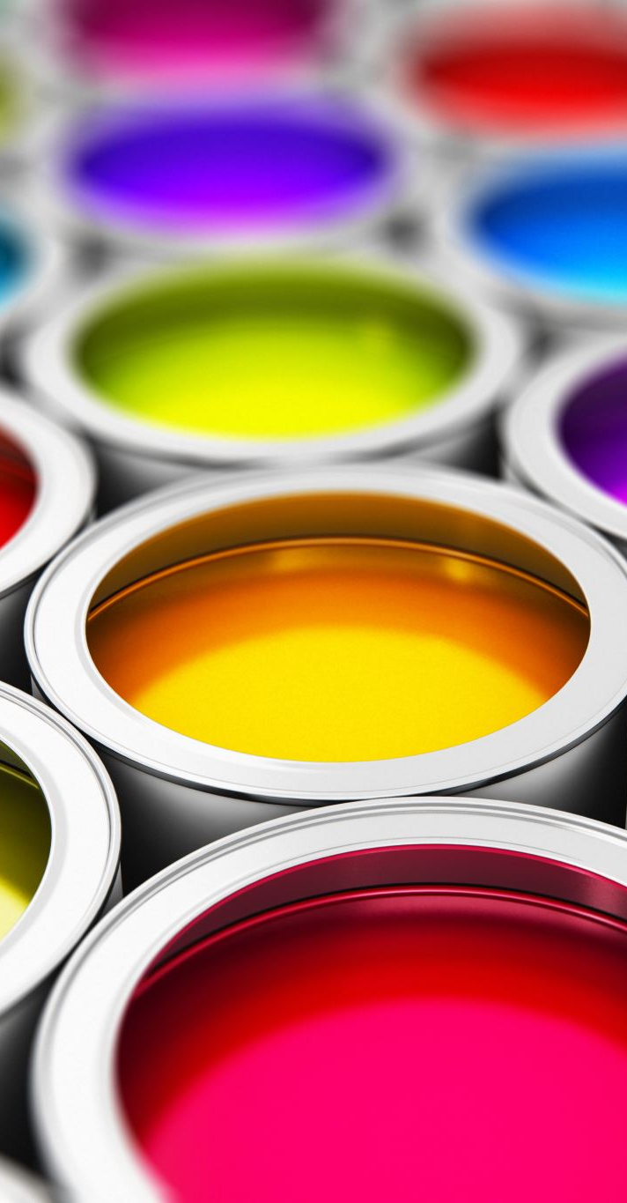
Color Models

Slide 2
Methods & Algorithms for Converting RGB to Grayscale
Average Method.
Luminance (Weighted Average) Method.
Desaturation Method.
Single Channel Extraction.
Principal Component Analysis (PCA):

Slide 3

Average Methdod
$$Gray= \frac{R+G+B}{3}$$
Example: Given an RGB pixel with color values:
R=120, G=200, B=80
Convert it to gray scale.

Slide 4
Average method to convert an image from RGB to Gray scale
#import cv2
import numpy as np
import matplotlib.pyplot as plt
# Function to convert RGB to grayscale using the average method
def rgb_to_gray_average(image):
# Calculate the average of the R, G, B channels
gray = np.mean(image, axis=2) # Take the mean along the 3rd axis (color channels) return gray
# Load an RGB image (use cv2.imread and convert to RGB)
image = cv2.imread('image.jpeg') # Read the image
image_rgb = cv2.cvtColor(image, cv2.COLOR_BGR2RGB) # Convert from BGR to RGB
# Convert to grayscale using the average method
gray_image = rgb_to_gray_average(image_rgb)
# Display the grayscale image using Matplotlib
plt.imshow(gray_image, cmap='gray')
plt.axis('off') # Hide the axis
plt.show()

Slide 5
Luminance (Weighted Average) Method
Gray = 0.2989×R + 0.5870 × G + 0.1140 × B
Red (R): Humans perceive red light as less bright compared to green, so the weight for red is 0.2989.
Green (G): Green is the most sensitive to the human eye, so it gets the highest weight of 0.5870.
Blue (B): Blue is the least sensitive to the human eye, so the weight for blue is 0.1140.

Slide 6
Standard Luminance Method Code in Python
import cv2
import numpy as np
import matplotlib.pyplot as plt
# Function to convert RGB to grayscale using luminance method
def rgb_to_gray_luminance(image):
# Extract individual R, G, B channels
R = image[:, :, 0]
G = image[:, :, 1]
B = image[:, :, 2]
# Apply the luminance formula gray = 0.2989 * R + 0.5870 * G + 0.1140 * B return gray
# Load an RGB image (use cv2.imread and convert to RGB)
image = cv2.imread('image.jpeg') # Read the image
image_rgb = cv2.cvtColor(image, cv2.COLOR_BGR2RGB) # Convert from BGR to RGB
# Convert to grayscale using the luminance method
gray_image = rgb_to_gray_luminance(image_rgb)
# Display the grayscale image using Matplotlib
plt.imshow(gray_image, cmap='gray')
plt.axis('off') # Hide the axis
plt.show()

Slide 7
Single Channel Extraction.
Extracting the Red Channel:
Gray=(R,0,0)
Extracting the Green Channel:
Gray=(0,G,0)
Extracting the Blue Channel:
Gray=(0,0,B)

Slide 8
Convert RGB to grayscale using Single Channel Extraction
import cv2
import numpy as np
import matplotlib.pyplot as plt
# Function to convert RGB to grayscale using Single Channel Extraction
def rgb_to_gray_single_channel(image, channel='R'):
# Extract individual channels
R = image[:, :, 0]
G = image[:, :, 1]
B = image[:, :, 2]
# Depending on the specified channel, extract that channel for grayscale
if channel == 'R':
return R
elif channel == 'G':
return G
elif channel == 'B':
return B
else:
raise ValueError("Invalid channel. Choose 'R', 'G', or 'B'.")

Slide 9
Continue…
# Load an RGB image (use cv2.imread and convert to RGB)
image = cv2.imread('image.jpg') # Read the image
image_rgb = cv2.cvtColor(image, cv2.COLOR_BGR2RGB) # Convert from BGR to RGB
# Convert to grayscale using the Red channel (R)
gray_image_r = rgb_to_gray_single_channel(image_rgb, 'R’)
# Convert to grayscale using the Green channel (G)
gray_image_g = rgb_to_gray_single_channel(image_rgb, ‘G’)
# Convert to grayscale using the Blue channel (B)
gray_image_b = rgb_to_gray_single_channel(image_rgb, ‘B’)
# Display the images using Matplotlib
fig, axes = plt.subplots(1, 3, figsize=(15, 5))
axes[0].imshow(gray_image_r, cmap='gray')
axes[0].set_title('Red Channel')
axes[0].axis('off’)

Slide 10
Continue…
axes[1].imshow(gray_image_g, cmap='gray')
axes[1].set_title('Green Channel')
axes[1].axis('off’)
axes[2].imshow(gray_image_b, cmap='gray')
axes[2].set_title('Blue Channel')
axes[2].axis('off')
plt.show()

Slide 11
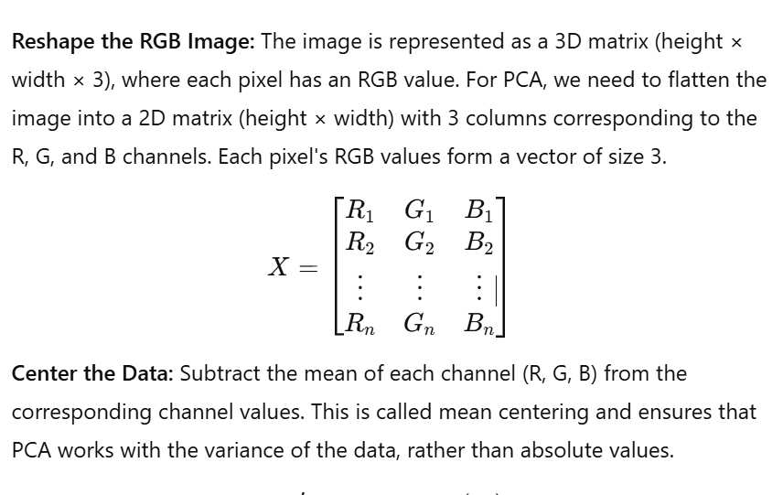
Principal Component Analysis (PCA)

Slide 12
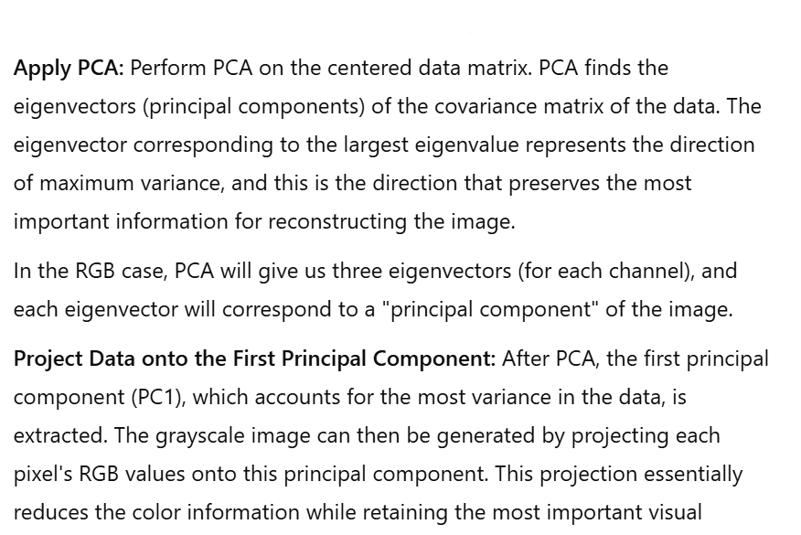
Principal Component Analysis (PCA)

Slide 13
PCA to convert an image from RGB to Gray
import numpy as np
from sklearn.decomposition import PCA
import cv2
import matplotlib.pyplot as plt
# Load the RGB image
image = cv2.imread('image.jpeg') # Load the image in BGR format
plt.imshow(image)
plt.show()
image_rgb = cv2.cvtColor(image, cv2.COLOR_BGR2RGB)
plt.imshow(image_rgb)
plt.show()
# Reshape the image to (num_pixels, 3)
pixels = image_rgb.reshape((-1, 3))
# Apply PCA
pca = PCA(n_components=1) # We only need the first principal component
gray_pixels = pca.fit_transform(pixels)
# Reshape the result back to the original image shape
gray_image = gray_pixels.reshape(image_rgb.shape[:2])
# Display the grayscale image
plt.imshow(gray_image, cmap='gray')
plt.axis('off')
plt.show()

Slide 14
Exercises
Convert an RGB image to grayscale using a weighted method.
Perform histogram equalization on an image in HSV color space.
Convert an RGB image to CMYK and compare color variations.
Extract color channels from an image and analyze their intensity.
Modify hue in an HSV image and observe color shifts.

